Slide 1
Tutorial 7 Multithreaded Programming

Slide 2
Exercise 1
Write a java program to demonstrate the thread with higher priority gets more CPU time than that of lower priority.

Slide 3
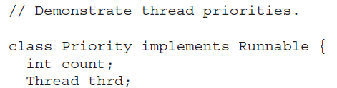
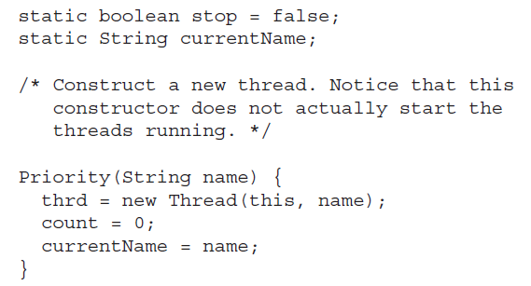

Slide 4
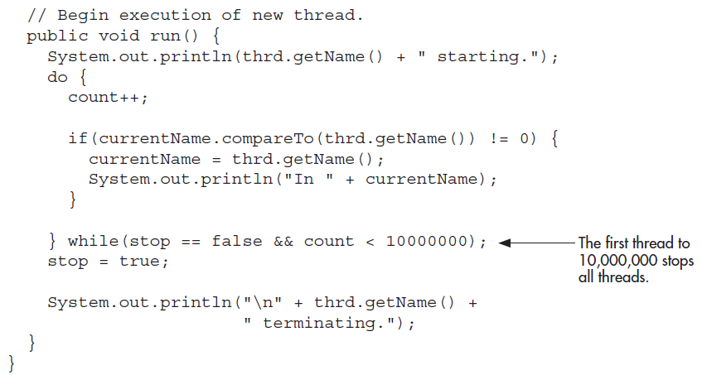

Slide 5
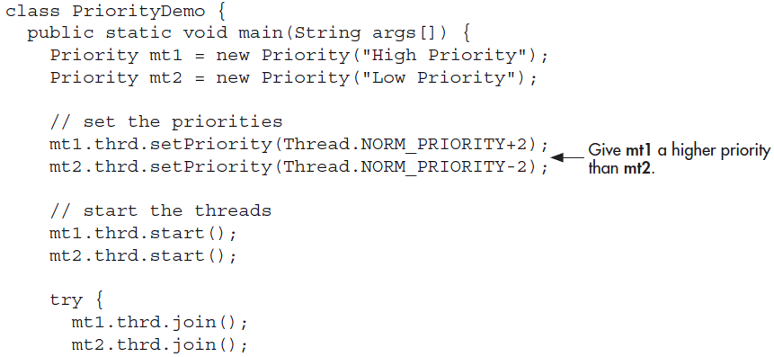

Slide 6
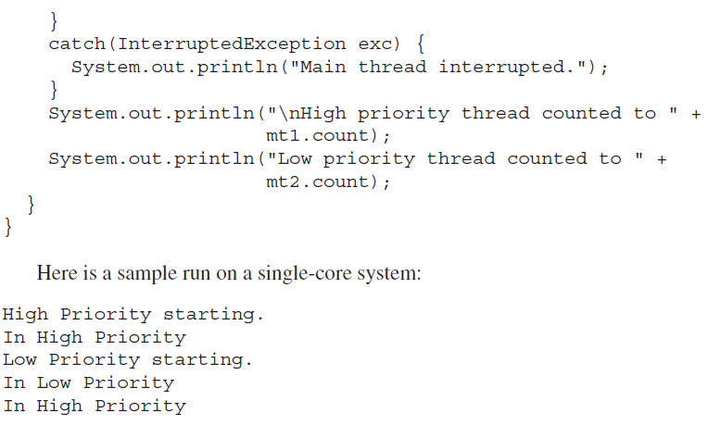

Slide 7
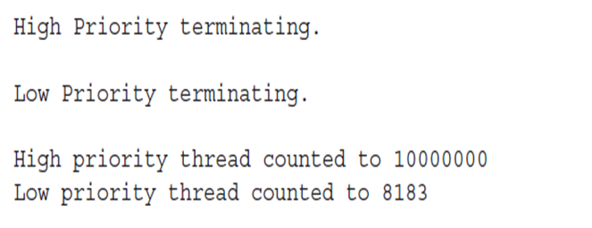
The threads are created as instances of Priority. The run( ) method contains a loop that counts the number of iterations.
The loop stops when either the count reaches 10,000,000 or the static variable stop is true. Initially, stop is set to false, but the first thread to finish counting sets stop to true.
This causes each other thread to terminate with its next time slice.

Slide 8
Exercise 2
Which integer between 1 and 10000 has the largest number of divisors, and how many divisors does it have? Write a program with multiple threads to find the answers and print out the results. It is possible that several integers in this range have the same, maximum number of divisors. Your program only has to print out one of them.

Slide 9
Exercise 3
Create a class by extending Thread Class to print a multiplication table of a number supplied as parameter. Create another class Tables which will instantiate two objects of the above class to print multiplication table of 5 and 7.

Slide 10
Exercise 4
Write and execute a java program to create and initialize a matrix of integers. Create n threads( by implementing Runnable interface) where n is equal to the number of rows in the matrix. Each of these threads should compute a distinct row sum. The main thread computes the complete sum by looking into the partial sums given by the threads.

Slide 11
Exercise 5
Write and execute a java program to create five threads, the first thread checking the uniqueness of matrix elements, the second calculating row sum, the third calculating the column sum, the fourth calculating principal diagonal sum, the fifth calculating the secondary diagonal sum of a given matrix. The main thread reads a square matrix from keyboard and will display whether the given matrix is magic square or not by obtaining the required data from sub threads.

